Slide 1


Social- Buzz Analysis

Slide 2


Today's agenda
Project recap
Problem
The Analytics team
Process
Insights
Summary

Slide 3

Social Buzz is a fast growing technology unicorn that need to adapt quickly to it's global scale. Accenture has begun a 3 month POC focusing on these tasks:
• An audit of Social Buzz's big data practice
Recommendations for a successful IPO
Analysis to find Social Buzz's top 5 most
popular categories of content
Project Recap

Slide 4


Problem
Over 100,000 posts per day.
Reuse 36,500,000 pieces of content per year!
OBJECTIVE :Analysis to find Social Buzz's top 5 most popular categories of content

Slide 5



Marcus Rompton
Senior Principle
The Analytics team
Nikhil
Data Analyst
Andrew Fleming
Chief Technical Architect

Slide 6
Data understanding
Process
1
2
Data Cleaning
3
Data Modelling
Data Analysis
4
5
Uncover insights

Slide 7

Insights
16
Unique Category
1897
Reaction to
Animal posts
January
Month with
Most posts

Slide 8
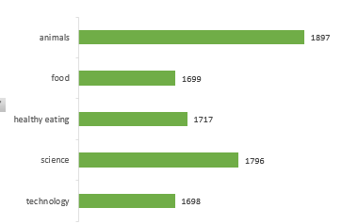
Top 5 Categories by Posts
Content category
Notes:
From our analysis, you can see that the top 5 most popular categories of posts were animals, science, healthy eating, technology and food in descending order. Animals had an aggregate popularity score of around 74965. It is very interesting to see both food and healthy eating within the top 5, it really shows that food is a highly engaging content category. Healthy eating ranks slightly higher than food, so perhaps your user base may be skewed towards healthy eaters and health-conscious people. Finally, its also interesting to see science and technology too. This may suggest that people enjoy consuming factual content and snippets of content that they can learn something from.

Slide 9
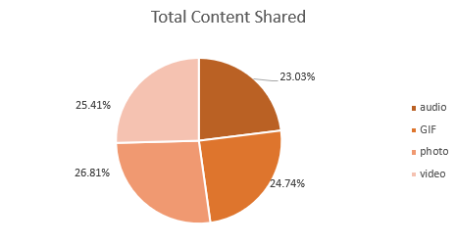
Content Type

Slide 10

animals and science are the two most popular categories, suggesting that users like "real-life" and "factual" content
food was a common amongst popular content and the most popular food category was healthy eating.
Summary

Slide 11

Thank you!
Nikhil
https://github.com/aspiringNikhil

